Slide 1


Proposal On Number Guessing Game App By
Group K8
Tutor: Abbas, Aamir
Module Name: DeveOps
Module Code: SWE7303

Slide 2
Outlines
Overview
Objectives
SDLC Model
SDLC Phases
Features
Project Timeline
Expected Outcomes
Conclusion
Possible Improvement

Slide 3
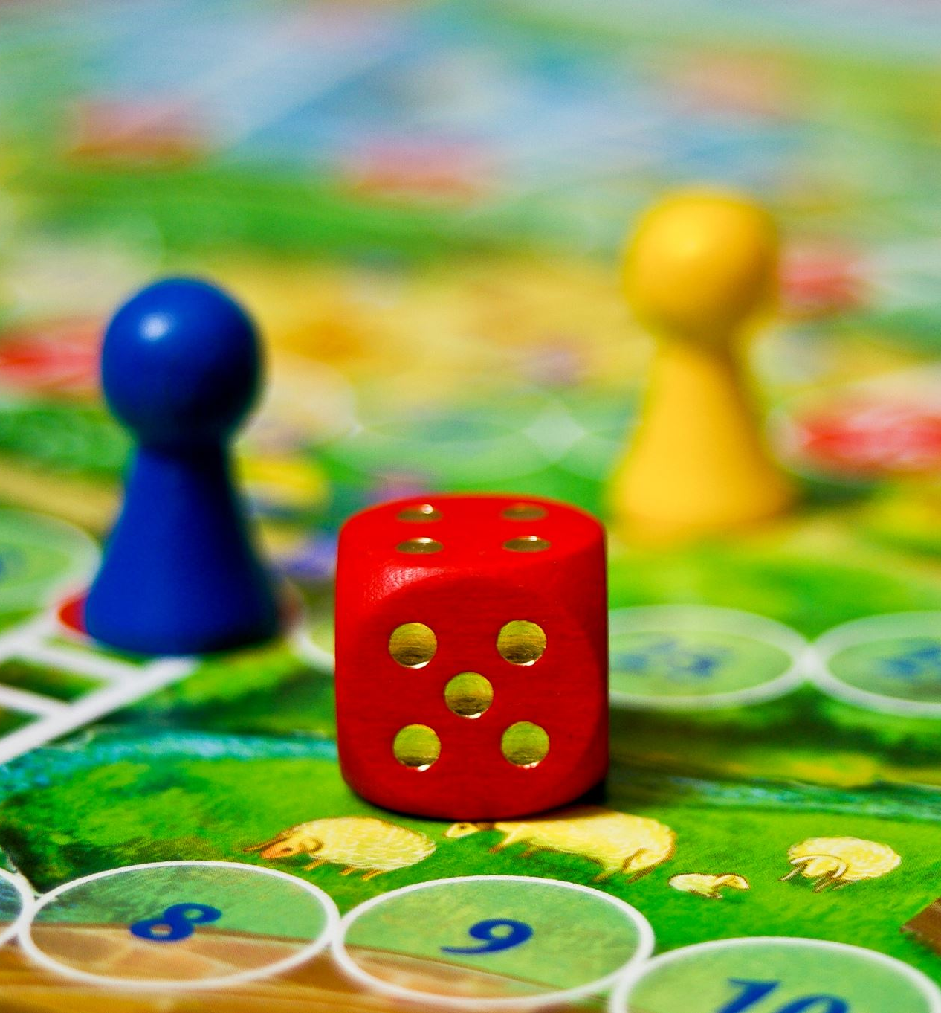
Overview
The Number Guessing Game App is an interactive game developed using Python. The game challenges players to guess a randomly generated number within a specified range, providing hints such as "higher" or "lower" to guide their guesses.
The project will incorporate various features, including a graphical user interface (GUI), timed mode, sound effects, Levels, animations, and a leaderboard.

Slide 4
Objectives
Develop an interactive and user-friendly Number Guessing Game.
Implement different game modes such as Timed Mode.
Enhance the gaming experience with GUI, animations, and sound effects.
Integrate a leaderboard for tracking scores.
Implement levels for player choice.
Ensure scalability and maintainability following SDLC principles.

Slide 5
SDLC Methodology
The SDLC model best suited for developing this app depends on complexity and requirements. Below are two possible models:
Waterfall Model (For Beginners & Small-Scale Development)
Agile Model (For Continuous Enhancements)
The Agile Model will be used for this project, enabling iterative development with continuous feedback and improvement.

Slide 6
SDLC Phases
Requirement Gathering: Define game rules (e.g., range of numbers, hints).
Design: Create UML diagrams, flowcharts, and UI layout.
Implementation: Code the game logic, UI, and local storage.
Testing: Debug and check for errors.
Deployment: Publish on platforms (if needed). Deploy on a AWS cloud server
Maintenance: Fix bugs and improve features. User feedback integration for future enhancements.

Slide 7
Algorithm
Generate a random number within a given range depending on the game level.
Prompt the user to enter a guess.
Compare the guessed number with the actual number.
If the guess is correct → Display a success message.
If the guess is too high → Display "Too High" and allow another attempt.
If the guess is too low → Display "Too Low" and allow another attempt.
Track the number of attempts.
Store best scores using local storage.
Optionally, allow restarting the game.

Slide 8

Features
Random Number Generation
User Input
Feedback System
Attempt Counter
Restart Option
User Login / Logout
Score Saving
Time Tracking
Responsive UI

Slide 9
Timeline
Phase | Duration
Planning | 1 Week
Requirement Analysis | 1 Week
Design | 2 Weeks
Implementation | 3 Weeks
Testing | 2 Weeks
Deployment | 1 Week
Maintenance | Ongoing

Slide 10
Expected Outcomes
A fully functional Number Guessing Game App.
Engaging UI with animations and sound effects.
Game Levels support.
Secure and scalable system architecture.
User-friendly experience with leaderboard tracking.

Slide 11
Conclusion
This project follows the SDLC methodology to ensure a structured and systematic development process. By incorporating engaging features, the Number Guessing Game App will provide an immersive and enjoyable user experience while demonstrating key software development principles.

Slide 12
Possible Improvements
Advanced Features
Difficulty Levels (Easy: 1-50, Medium: 1-100, Hard: 1-500).
Leaderboard (Show top players with the least attempts).
Timer (Challenge players to guess within a time limit).
Multiplayer Mode (Compete with friends).
AI Opponent (Have an AI guess the number too).
Speech Recognition (Allow voice input for guessing).
Mobile & Web Version (Cross-platform support).

